Slide 1
Murach’s ASP.NET Core MVC (2nd Ed.)
Chapter 2
How to develop a one-page MVC web app

Slide 2
Objectives (part 1)
Applied
Given the specifications for a one-page MVC web app, write the C# code for the model and controller classes and write the C# code and HTML for the Razor view.
Given an ASP.NET Core MVC web app, run it on your own computer.
Knowledge
Describe how to use Visual Studio to create an ASP.NET Core project and add the folders and files necessary for an MVC web app.
List the names of six folders that are included in an MVC web app by convention.
Describe how a controller and its action methods work.

Slide 3
Objectives (part 2)
Describe how you can use the ViewBag property to transfer data from a controller to a view.
Distinguish between a Razor code block and a Razor expression.
In general terms, describe how to use the Program.cs file to configure the HTTP request and response pipeline for a simple ASP.NET Core MVC web app.
Distinguish between a model class and a controller class.
Describe the purpose of a Razor view imports page.
Describe how you can use the @model directive and asp-for tag helpers to create a strongly-typed view.
Describe how you can use the asp-controller and asp-action tag helpers to specify the controller and action method for a form or a link.

Slide 4
Objectives (part 3)
Describe how the HttpGet and HttpPost attributes allow you to code action methods so they can handle HTTP GET or POST requests.
Describe the purpose of a CSS style sheet for an app.
Distinguish between a Razor layout and a Razor view.
Describe the purpose of a Razor view start.
In general terms, describe how ASP.NET Core MVC provides for validating the data that’s entered by a user.

Slide 5
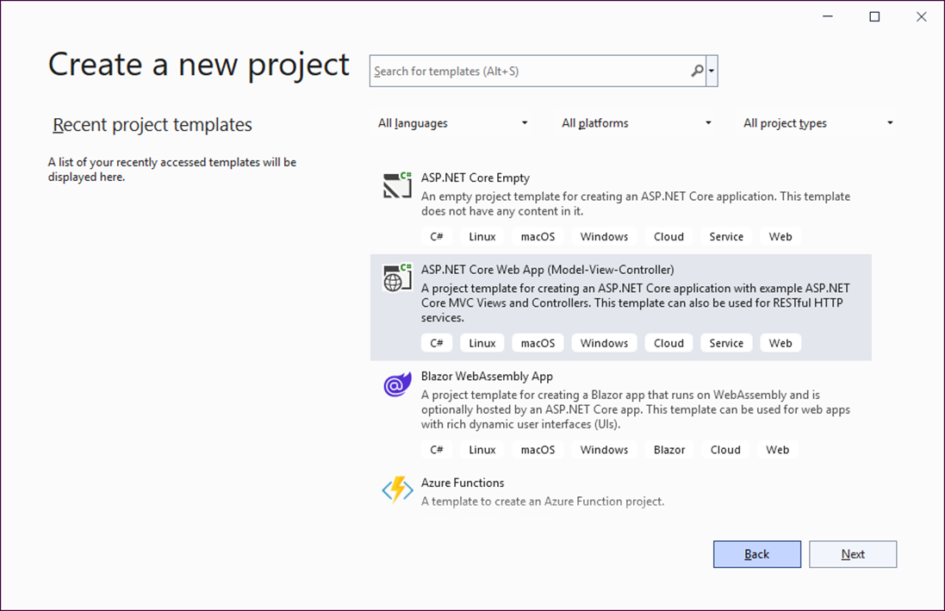
The dialog that displays the project templates

Slide 6
The templates presented in this book
Template | Contains…
Web App MVC | Starting folders and files for an ASP.NET Core MVC web app.
Empty | Two starting files for an ASP.NET Core app.
How to create a new project
Select File→New→Project from the menu system, select the template you want to use, and then click the Next button.

Slide 7
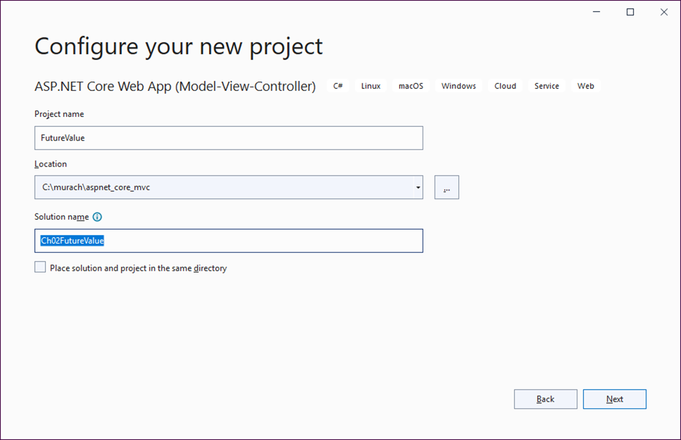
The dialog for configuring a new web app

Slide 8
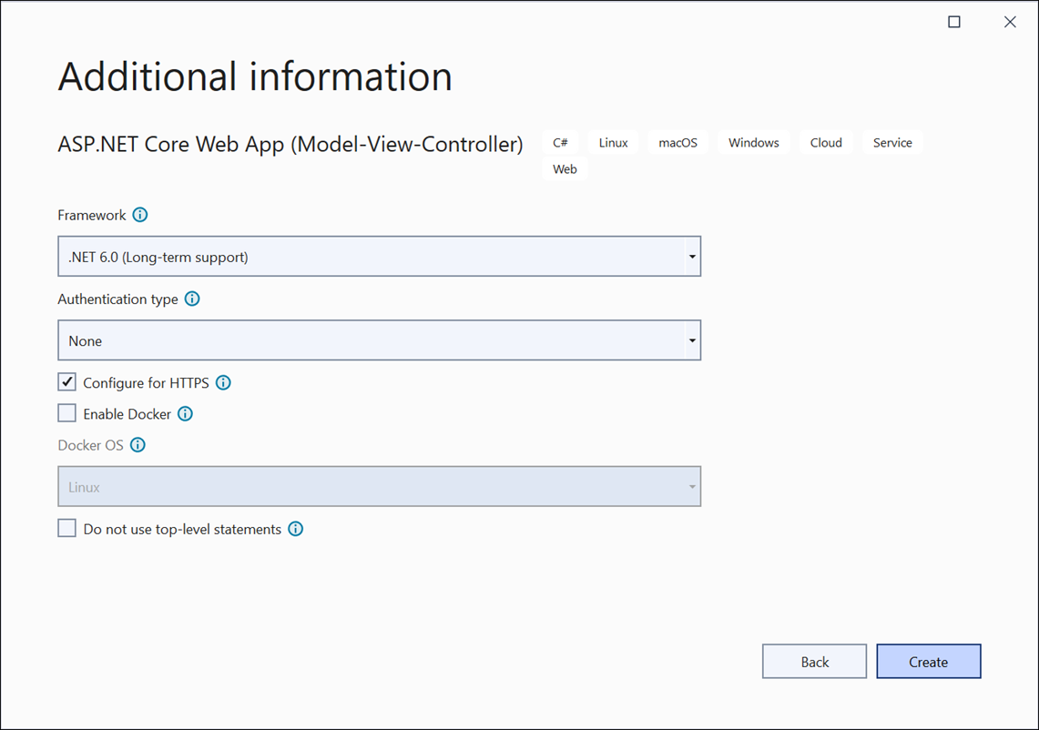
The dialog for providing additional information

Slide 9
How to configure an ASP.NET Core MVC web app
Enter a project name.
Specify the location (folder). To do that, you can click the Browse […] button.
Edit the solution name if necessary, and then click the Next button.
Use the resulting dialog to provide any additional information for the web app and click Create.

Slide 10
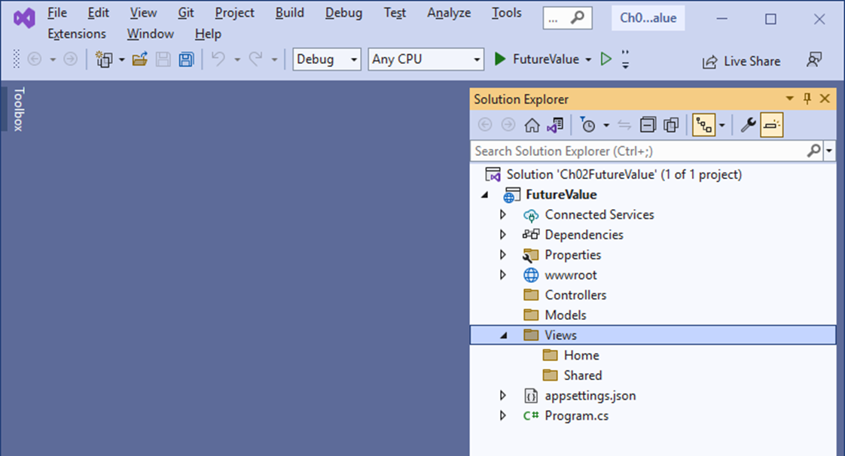
Visual Studio with the folders for an MVC web app

Slide 11
How to delete files from the MVC template
Expand the Controllers folder and delete all files in that folder.
Expand the Models folder and delete all files in that folder.
Expand the Views folder and its subfolders and delete all files in those folders, but don’t delete the folders.

Slide 12
How to add folders to the Empty template
Add the Controllers, Models, and Views folders.
Within the Views folder, add the Home and Shared folders.

Slide 13
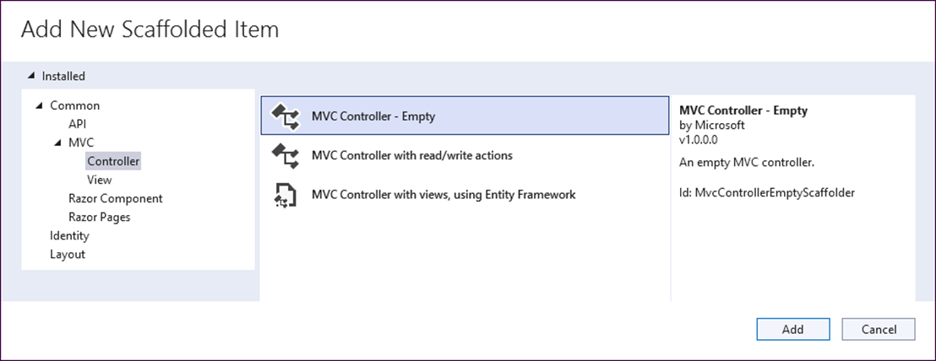
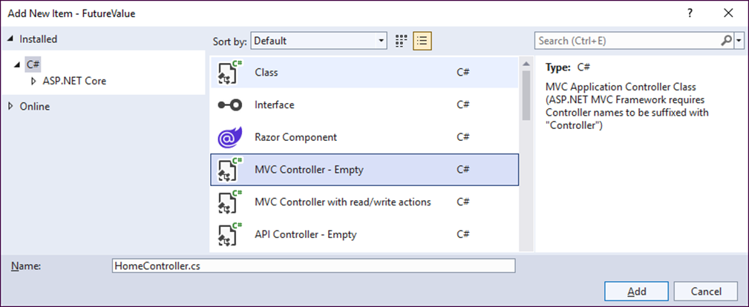
The dialogs for adding a controller

Slide 14
How to add a file for a controller
Right-click the Controllers folder and select Add→Controller.
In the Add New Scaffolded Item dialog, select “MVC Controller – Empty” and click Add.
In the Add New Item dialog, name the controller and click Add.

Slide 15
The HomeController.cs file
using Microsoft.AspNetCore.Mvc;
namespace FutureValue.Controllers
{
public class HomeController : Controller
{
public IActionResult Index()
{
ViewBag.Name = "Mary";
ViewBag.FV = 99999.99;
return View();
}
}
}

Slide 16
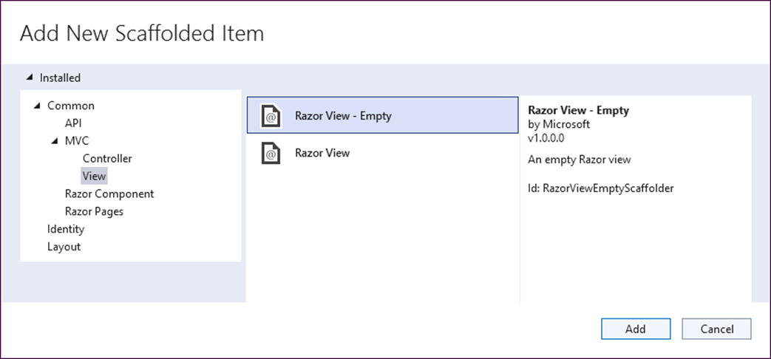
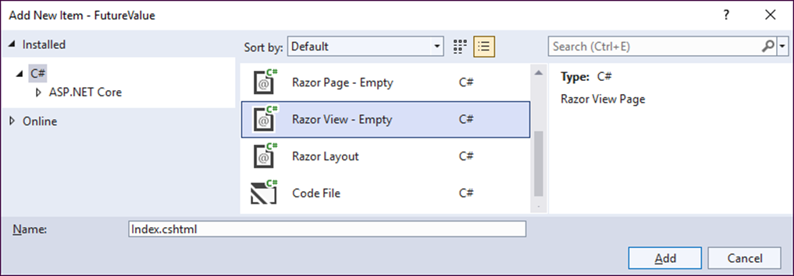
The dialogs for adding a Razor view

Slide 17
How to add a view to the Views/Home folder
In the Solution Explorer, right-click the Views/Home folder and select Add→View.
In the Add New Scaffolded Item dialog, select Razor View – Empty and click Add.
In Add New Item dialog, name the view Index and click Add.

Slide 18
The Home/Index.cshtml view
@{
Layout = null;
}
<!DOCTYPE html>
<html>
<head>
<meta name="viewport" content="width=device-width" />
<title>Home Page</title>
</head>
<body>
<h1>Future Value Calculator</h1>
<p>Customer Name: @ViewBag.Name</p>
<p>Future Value: @ViewBag.FV.ToString("C2")</p>
</body>
</html>

Slide 19
The Program.cs file that’s generated (part 1)
var builder = WebApplication.CreateBuilder(args);
// Add services to the container.
builder.Services.AddControllersWithViews();
var app = builder.Build();
// Configure the HTTP request pipeline.
if (!app.Environment.IsDevelopment())
{
app.UseExceptionHandler("/Home/Error");
// The default HSTS value is 30 days.
// You may want to change this
// for production scenarios, see
// https://aka.ms/aspnetcore-hsts.
app.UseHsts();
}

Slide 20
The Program.cs file that’s generated (part 2)
app.UseHttpsRedirection();
app.UseStaticFiles();
app.UseRouting();
app.UseAuthorization();
app.MapControllerRoute(
name: "default",
pattern: "{controller=Home}/{action=Index}/{id?}");
app.Run();

Slide 21
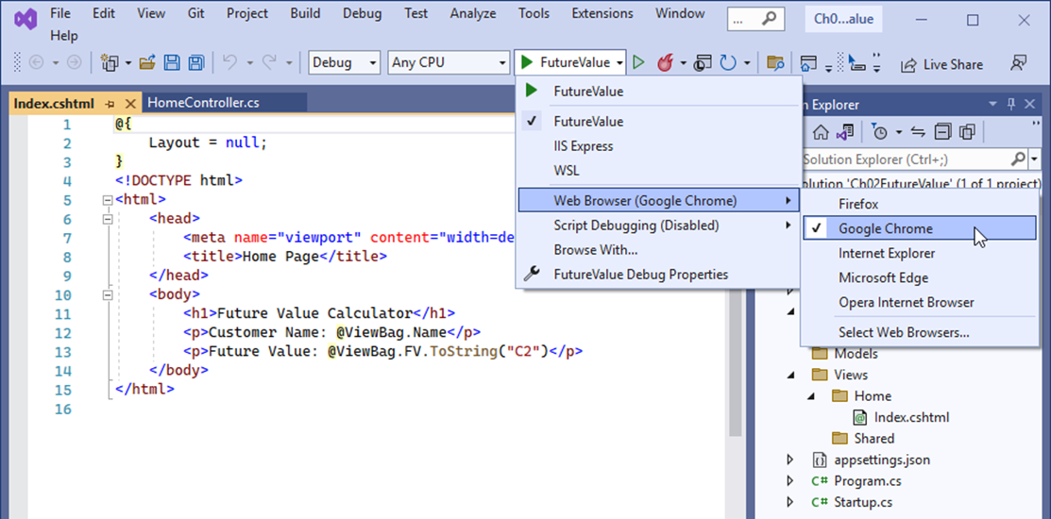
The Start button drop-down list in Visual Studio

Slide 22
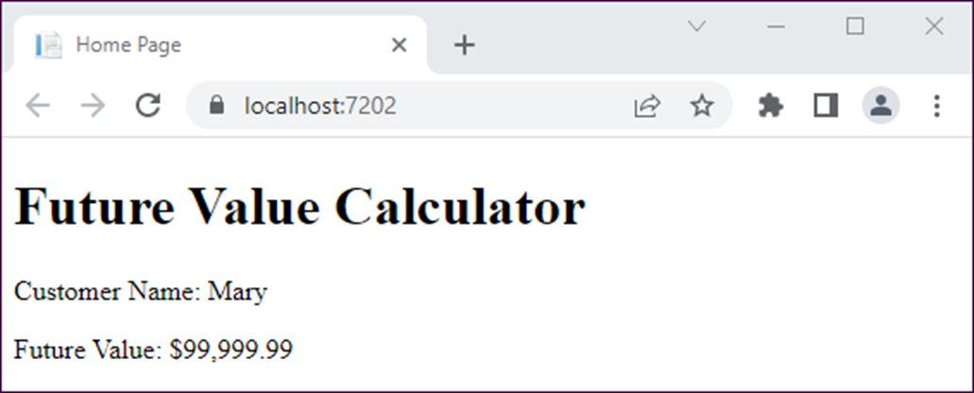
The Future Value app in the Chrome browser

Slide 23
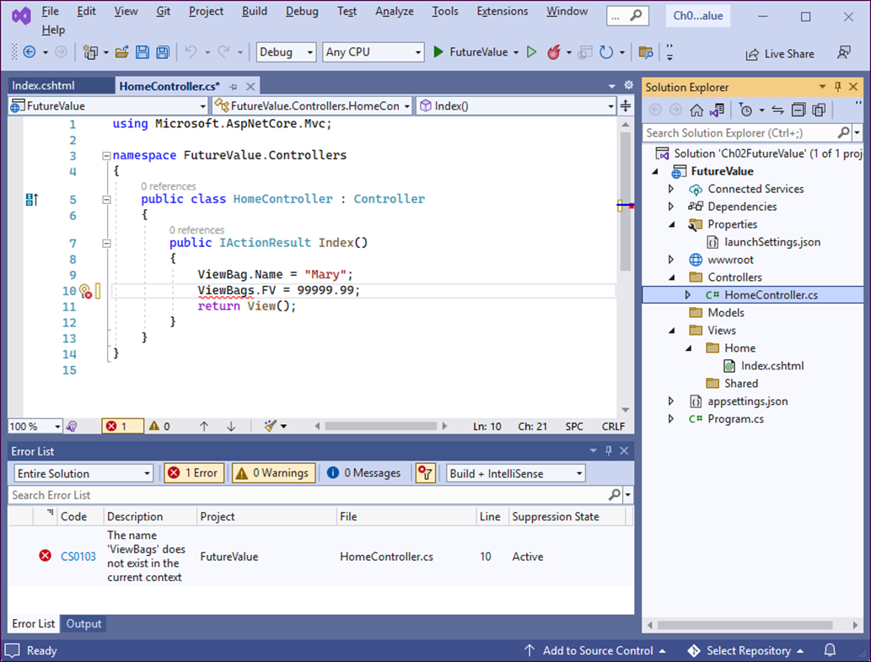
The Error List window in Visual Studio

Slide 24
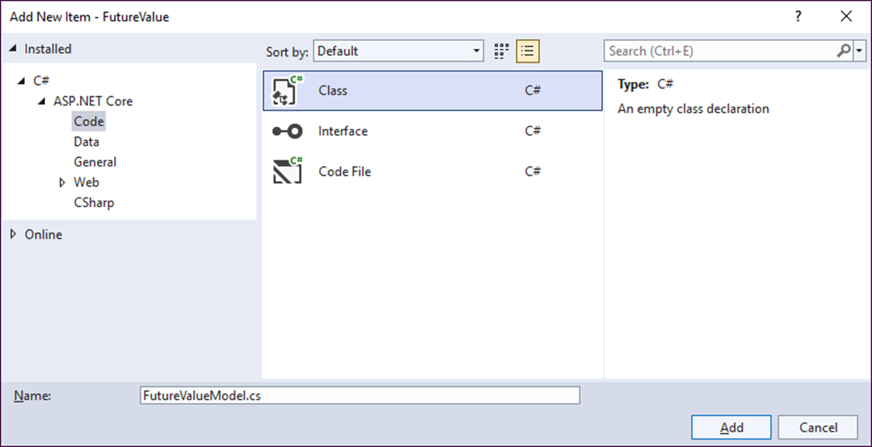
The dialog for adding a class

Slide 25
How to add a file for a model class
In the Solution Explorer, right-click the Models folder and select Add→Class.
In the resulting dialog, enter the name of the class, and click the Add button.

Slide 26
The FutureValueModel class with three properties and a method
namespace FutureValue.Models
{
public class FutureValueModel
{
public decimal MonthlyInvestment { get; set; }
public decimal YearlyInterestRate { get; set; }
public int Years { get; set; }
public decimal CalculateFutureValue()
{
int months = Years * 12;
decimal monthlyInterestRate =
YearlyInterestRate / 12 / 100;
decimal futureValue = 0;
for (int i = 0; i < months; i++)
{
futureValue = (futureValue + MonthlyInvestment) *
(1 + monthlyInterestRate);
}
return futureValue;
}
}
}

Slide 27
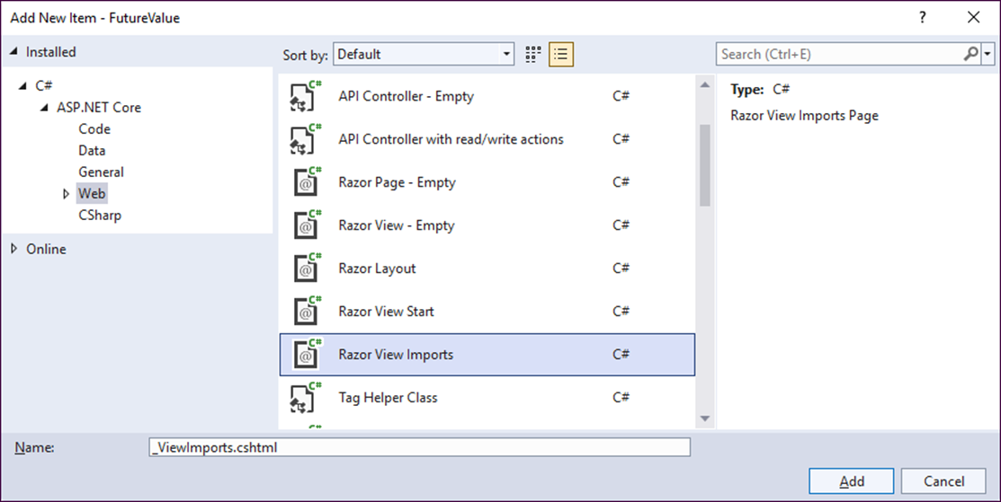
The dialog for adding a Razor view imports page

Slide 28
How to add a Razor view imports page
In the Solution Explorer, right-click the Views folder and select Add→New Item.
In the resulting dialog, select the Installed→ASP.NET Core→Web category, select the Razor View Imports item, and click the Add button.

Slide 29
The Views/_ViewImports.cshtml file for the Future Value app
@using FutureValue.Models
@addTagHelper *, Microsoft.AspNetCore.Mvc.TagHelpers
A Razor view imports page makes it easier to work with…
Model classes.
Tag helpers.

Slide 30
Common tag helpers for forms
Tag helper | HTML tags
asp-for | <label> <input>
asp-action | <form> <a>
asp-controller | <form> <a>

Slide 31
A strongly-typed Index view with tag helpers (part 1)
@model FutureValueModel
@{
Layout = null;
}
<!DOCTYPE html>
<html>
<head>
<meta name="viewport"
content="width=device-width, initial-scale=1.0" />
<title>Future Value Calculator</title>
<style>
/* all of the CSS styles from figure 2-14 go here */
</style>
</head>
<body>
<h1>Future Value Calculator</h1>
<form asp-action="Index" method="post">
<div>
<label asp-for="MonthlyInvestment">
Monthly Investment:</label>
<input asp-for="MonthlyInvestment" />
</div>

Slide 32
A strongly-typed Index view with tag helpers (part 2)
<div>
<label asp-for="YearlyInterestRate">
Yearly Interest Rate:</label>
<input asp-for="YearlyInterestRate" />
</div>
<div>
<label asp-for="Years">Number of Years:</label>
<input asp-for="Years" />
</div>
<div>
<label>Future Value:</label>
<input value="@ViewBag.FV.ToString("C2")" readonly>
</div>
<button type="submit">Calculate</button>
<a asp-action="Index">Clear</a>
</form>
</body>
</html>

Slide 33
Attributes that indicate the HTTP verb an action method handles
HttpGet
HttpPost
Methods for returning a view from a controller
View()
View(model)

Slide 34
An overloaded Index() action method
using Microsoft.AspNetCore.Mvc;
using FutureValue.Models;
public class HomeController : Controller
{
[HttpGet]
public IActionResult Index()
{
ViewBag.FV = 0;
return View();
}
[HttpPost]
public IActionResult Index(FutureValueModel model)
{
ViewBag.FV = model.CalculateFutureValue();
return View(model);
}
}

Slide 35
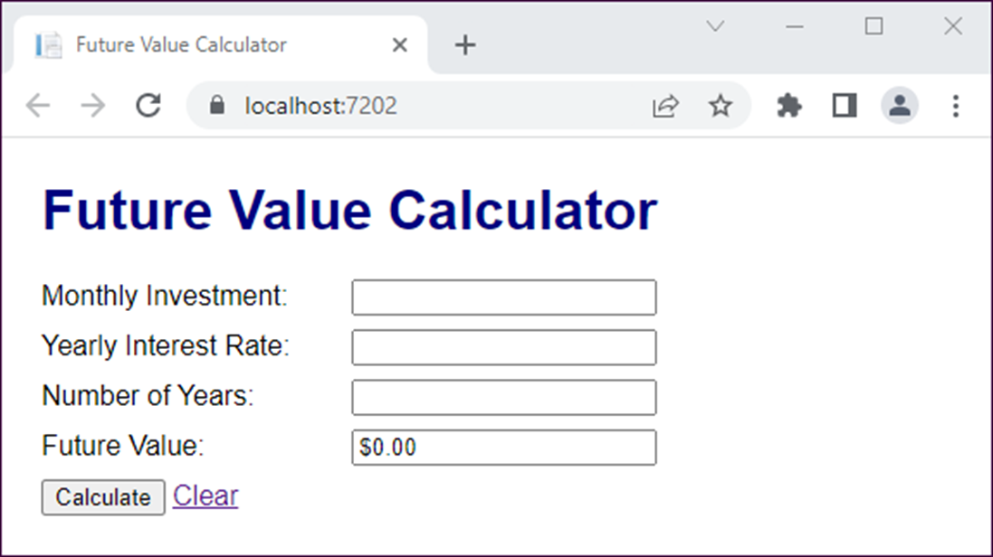
The Future Value app after a GET request

Slide 36
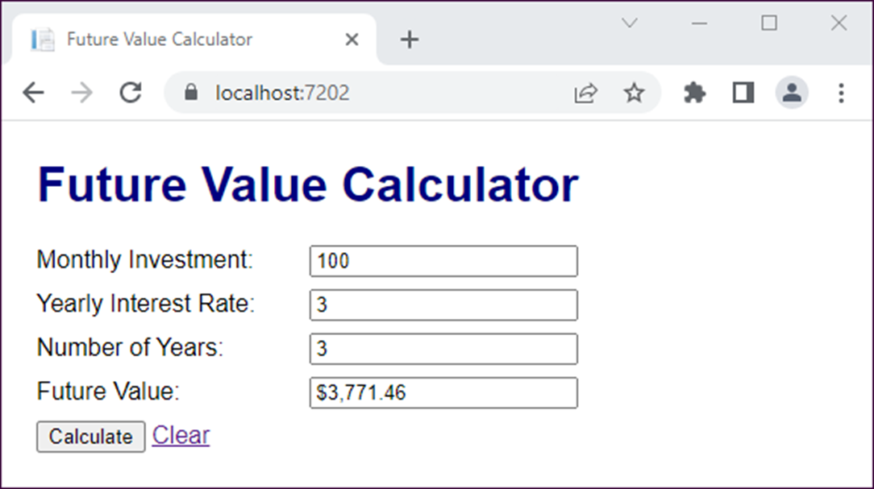
The Future Value app after a POST request

Slide 37
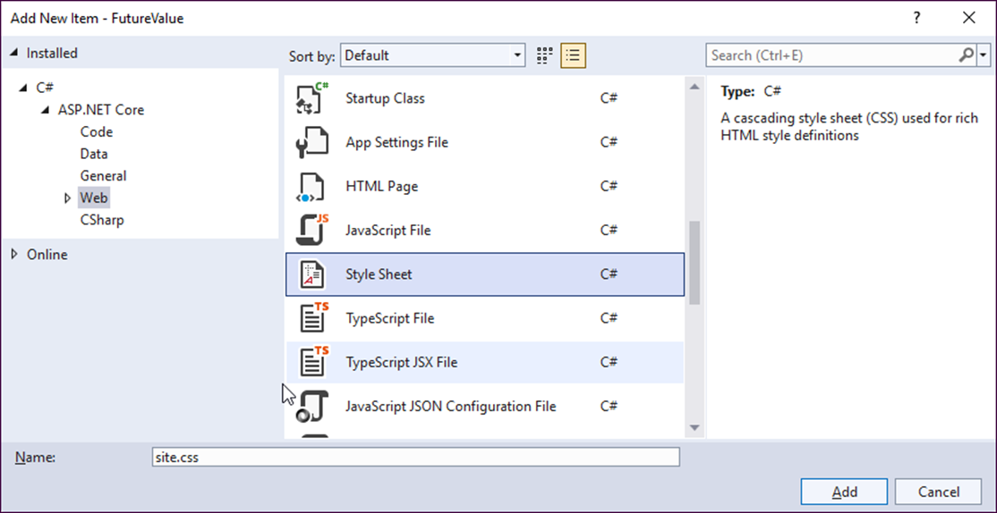
The dialog for adding a CSS style sheet

Slide 38
How to add a CSS style sheet
If the wwwroot/css folder doesn’t exist, create it.
Right-click the wwwroot/css folder and select Add→New Item.
Select the ASP.NET Core→Web category, select the Style Sheet item, enter a name for the CSS file, and click the Add button.

Slide 39
The site.css file for the Future Value app
body {
padding: 1em;
font-family: Arial, Helvetica, sans-serif;
}
h1 {
margin-top: 0;
color: navy;
}
label {
display: inline-block;
width: 10em;
padding-right: 1em;
}
div {
margin-bottom: .5em;
}

Slide 40
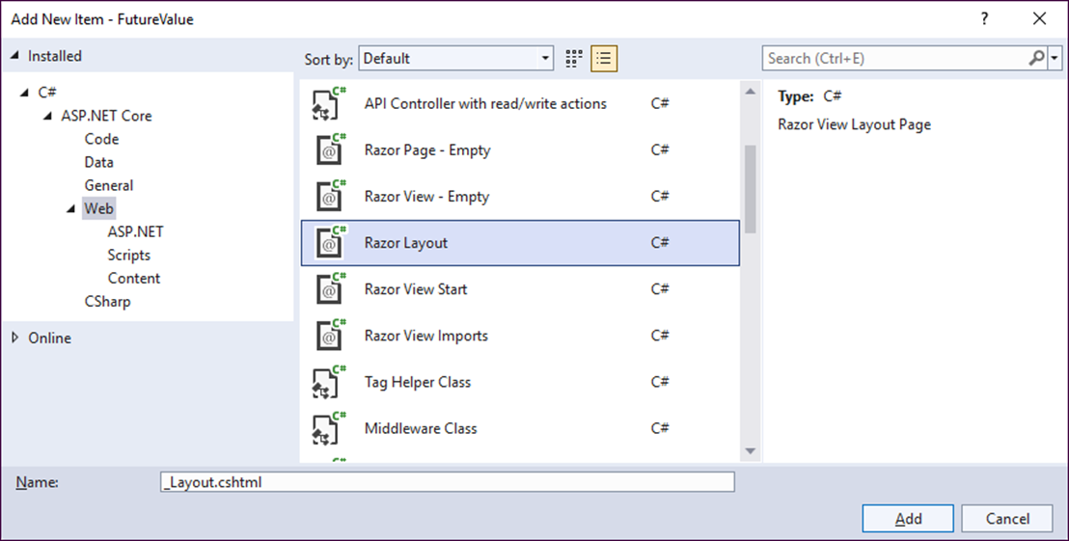
The dialog for adding a Razor layout or view start

Slide 41
How to add a Razor layout
Right-click the Views/Shared folder and select Add→New Item.
Select the ASP.NET Core→Web category, select the Razor Layout item, and click the Add button.

Slide 42
How to add a Razor view start
Right-click the Views folder (not the Views/Shared folder) and select Add→New Item.
Select the ASP.NET Core→Web category, select the Razor View Start item, and click the Add button.

Slide 43
The Views/Shared/_Layout.cshtml file
<!DOCTYPE html>
<html>
<head>
<meta name="viewport"
content="width=device-width, initial-scale=1.0" />
<title>@ViewBag.Title</title>
<link rel="stylesheet" href="~/css/site.css" />
</head>
<body>
<div>
@RenderBody()
</div>
</body>
</html>
The Views/_ViewStart.cshtml file
@{
Layout = "_Layout";
}

Slide 44
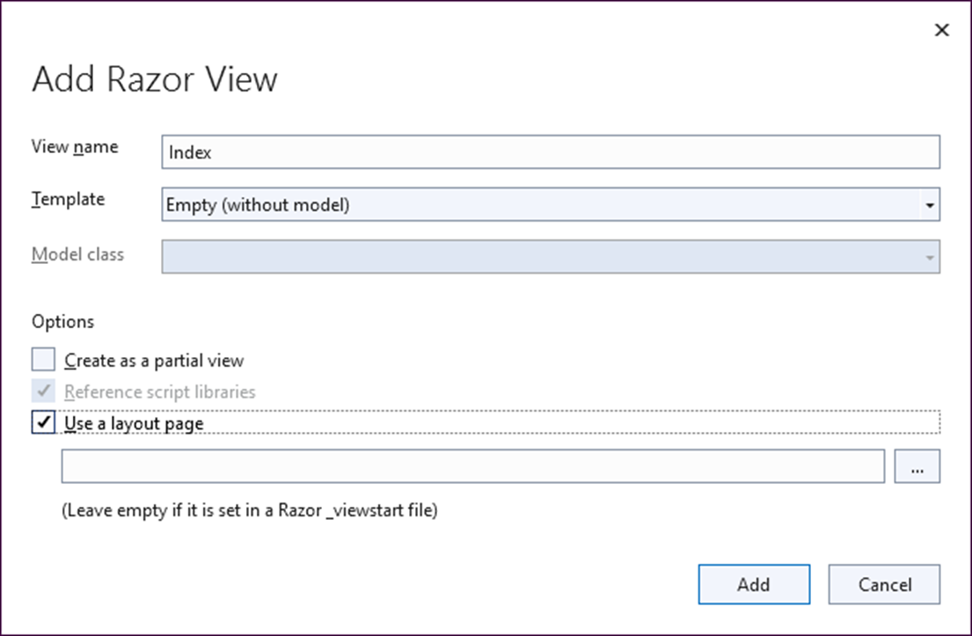
The dialog for adding a Razor view

Slide 45
How to add a Razor view
Right-click the folder for the view (Views/Home, for example) and select Add→View.
Use the Add New Scaffolded Item dialog from figure 2-5 to select Razor View, and then click Add.
Use the Add Razor View dialog to enter a name for the view, make sure that the “Use a layout page” item is selected, but don’t specify a name for the layout page.

Slide 46
The Views/Home/Index.cshtml file
@model FutureValueModel
@{
ViewData["Title"] = "Future Value Calculator";
}
<h1>Future Value Calculator</h1>
<form asp-action="Index" method="post">
<div>
<label asp-for="MonthlyInvestment">
Monthly Investment:</label>
<input asp-for="MonthlyInvestment" /></div>
<div>
<label asp-for="YearlyInterestRate">
Yearly Interest Rate:</label>
<input asp-for="YearlyInterestRate" /></div>
<div>
<label asp-for="Years">Number of Years:</label>
<input asp-for="Years" /></div>
<div>
<label>Future Value:</label>
<label>@ViewBag.FV.ToString("c2")</label></div>
<button type="submit">Calculate</button>
<a asp-action="Index">Clear</a>
</form>

Slide 47
How to import the DataAnnotations namespace
using System.ComponentModel.DataAnnotations;
Two common validation attributes
Required
Range(min, max)

Slide 48
A model property with a validation attribute
[Required]
public decimal? MonthlyInvestment { get; set; }
The default error message if the property isn’t set
The field MonthlyInvestment is required.

Slide 49
A model property with two validation attributes
[Required]
[Range(1, 500)]
public decimal? MonthlyInvestment { get; set; }
The default error message if the property isn’t in a valid range
The field MonthlyInvestment must be between 1 and 500.

Slide 50
A model property with user-friendly error messages
[Required(ErrorMessage =
"Please enter a monthly investment amount.")]
[Range(1, 500, ErrorMessage =
"Monthly investment amount must be between 1 and 500.")]
public decimal? MonthlyInvestment { get; set; }

Slide 51
The model class with data validation attributes (part 1)
using System.ComponentModel.DataAnnotations;
namespace FutureValue.Models
{
public class FutureValueModel
{
[Required(ErrorMessage =
"Please enter a monthly investment.")]
[Range(1, 500, ErrorMessage =
"Monthly investment amount must be between 1 and 500.")]
public decimal? MonthlyInvestment { get; set; }
[Required(ErrorMessage =
"Please enter a yearly interest rate.")]
[Range(0.1, 10.0, ErrorMessage =
"Yearly interest rate must be between 0.1 and 10.0.")]
public decimal? YearlyInterestRate { get; set; }

Slide 52
The model class with data validation attributes (part 2)
[Required(ErrorMessage = "Please enter a number of years.")]
[Range(1, 50, ErrorMessage =
"Number of years must be between 1 and 50.")]
public int? Years { get; set; }
public decimal? CalculateFutureValue()
{
int? months = Years * 12;
decimal? monthlyInterestRate =
YearlyInterestRate / 12 / 100;
decimal? futureValue = 0;
for (int i = 0; i < months; i++)
{
futureValue = (futureValue + MonthlyInvestment) *
(1 + monthlyInterestRate);
}
return futureValue;
}
}
}

Slide 53
An action method that checks for invalid data
[HttpPost]
public IActionResult Index(FutureValueModel model)
{
if (ModelState.IsValid)
{
ViewBag.FV = model.CalculateFutureValue();
}
else
{
ViewBag.FV = 0;
}
return View(model);
}

Slide 54
A view that displays a summary of validation messages
<form asp-action="Index" method="post">
<div asp-validation-summary="All"></div>
<div>
<label asp-for="MonthlyInvestment">
Monthly Investment:</label>
<input asp-for="MonthlyInvestment" />
</div>
<!-- rest of input form -->
</form>

Slide 55
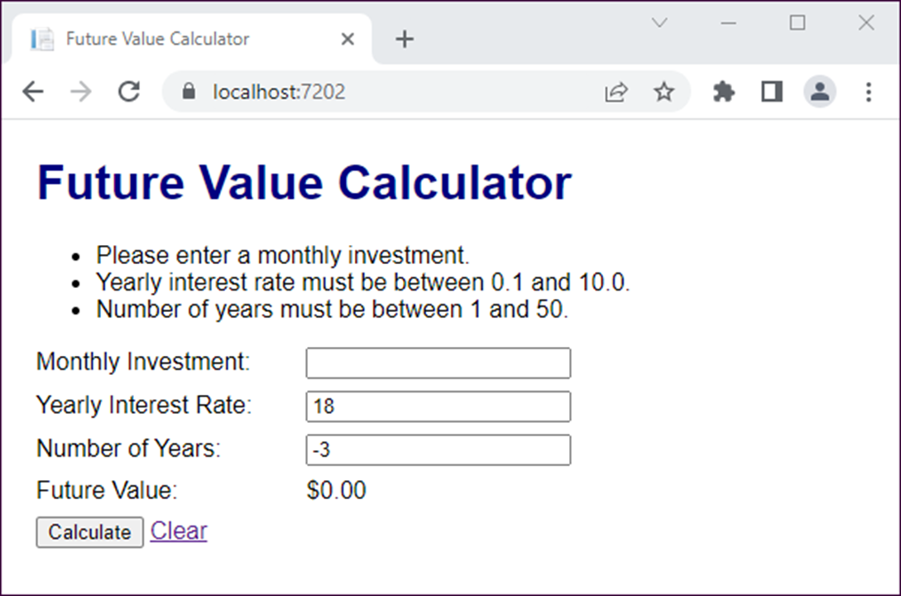
The Future Value app with invalid data

